Slide 1


Practical Applications of Generative AI in HR
London People Analytics Meetup
July 2024

Slide 2
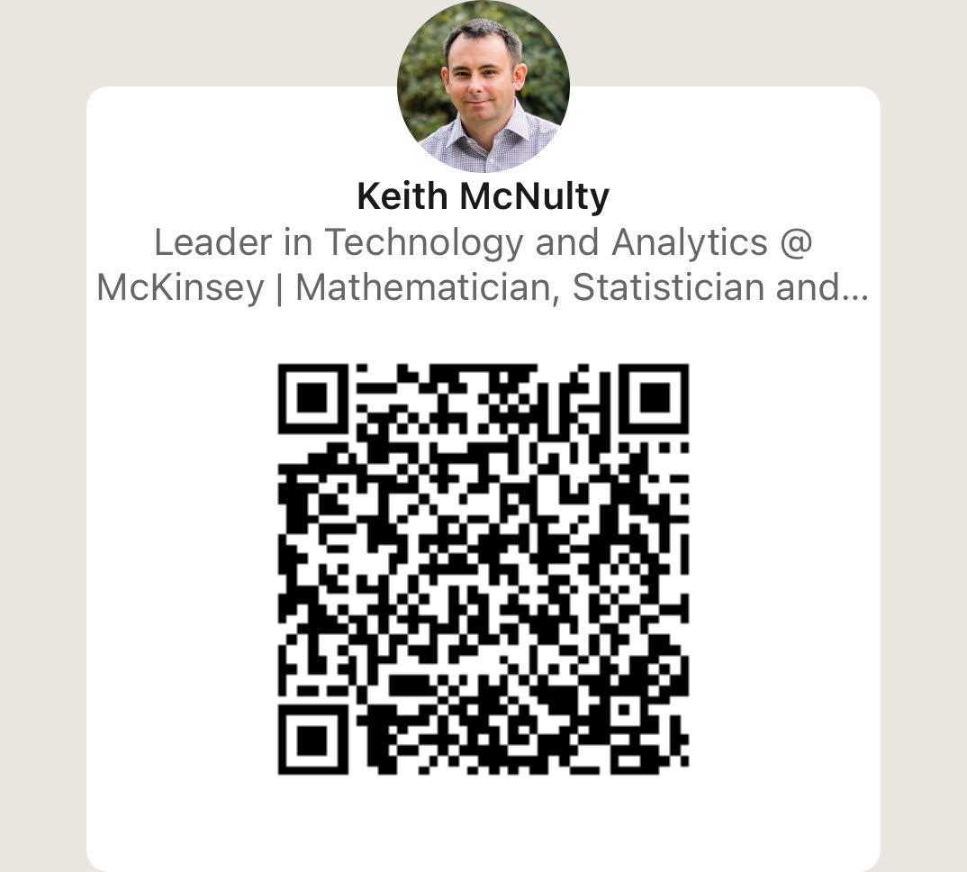
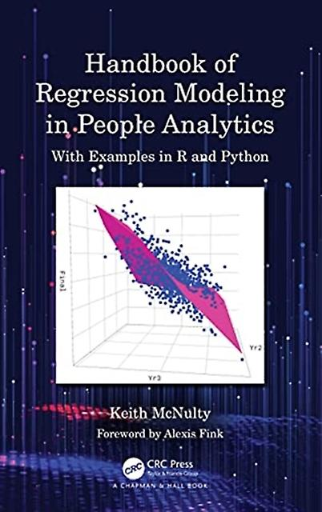
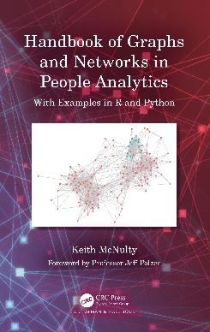
Keith McNulty
Global Leader in Technology & Analytics, McKinsey & Company

Slide 3





Objectives of today’s talk
Pizza break!
Baseline our understanding of what large language models are and how they work
Review the opportunities and challenges presented by Generative AI
Review the Three C’s of successful GenAI applications
‘Hands on’ development of example GenAI-enabled application
Q&A
10 mins
15 mins
5 mins
25 mins
5 mins

Slide 4

Agenda
What is GenAI and how does it work?
What are the opportunities and challenges of GenAI?
The Three C’s of Successful GenAI applications
Hands on: Building a GenAI enabled application

Slide 5

Some potential definitions for AI and Generative AI
AI (Artificial Intelligence)
Generative AI
The simulation of human intelligence processes by machines, especially computer systems
The use of machines or computer systems to mimic the various aspects of human thought, including learning, reasoning, self-correction and creativity
The use of computing technology to absorb large amounts of data, identify patterns that humans do not have the capacity to identify, and generate insights or recommendations based on this
A subset of AI technologies that generate various forms of content, including text, audio, images and video
Artificial intelligence which is capable of generating text, images or other media, using generative models
AI models which identify the patterns and structure of their input training data and then generate new data that has similar characteristics

Slide 6
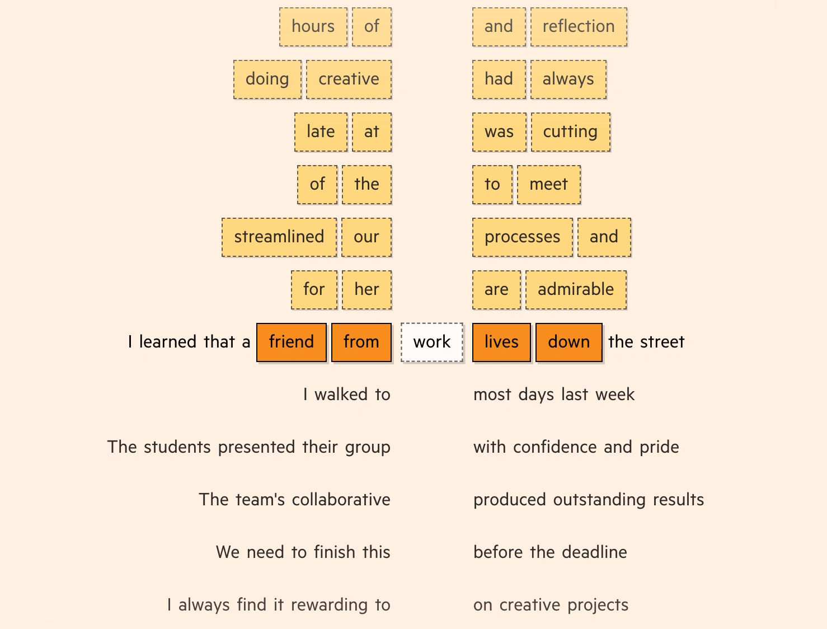
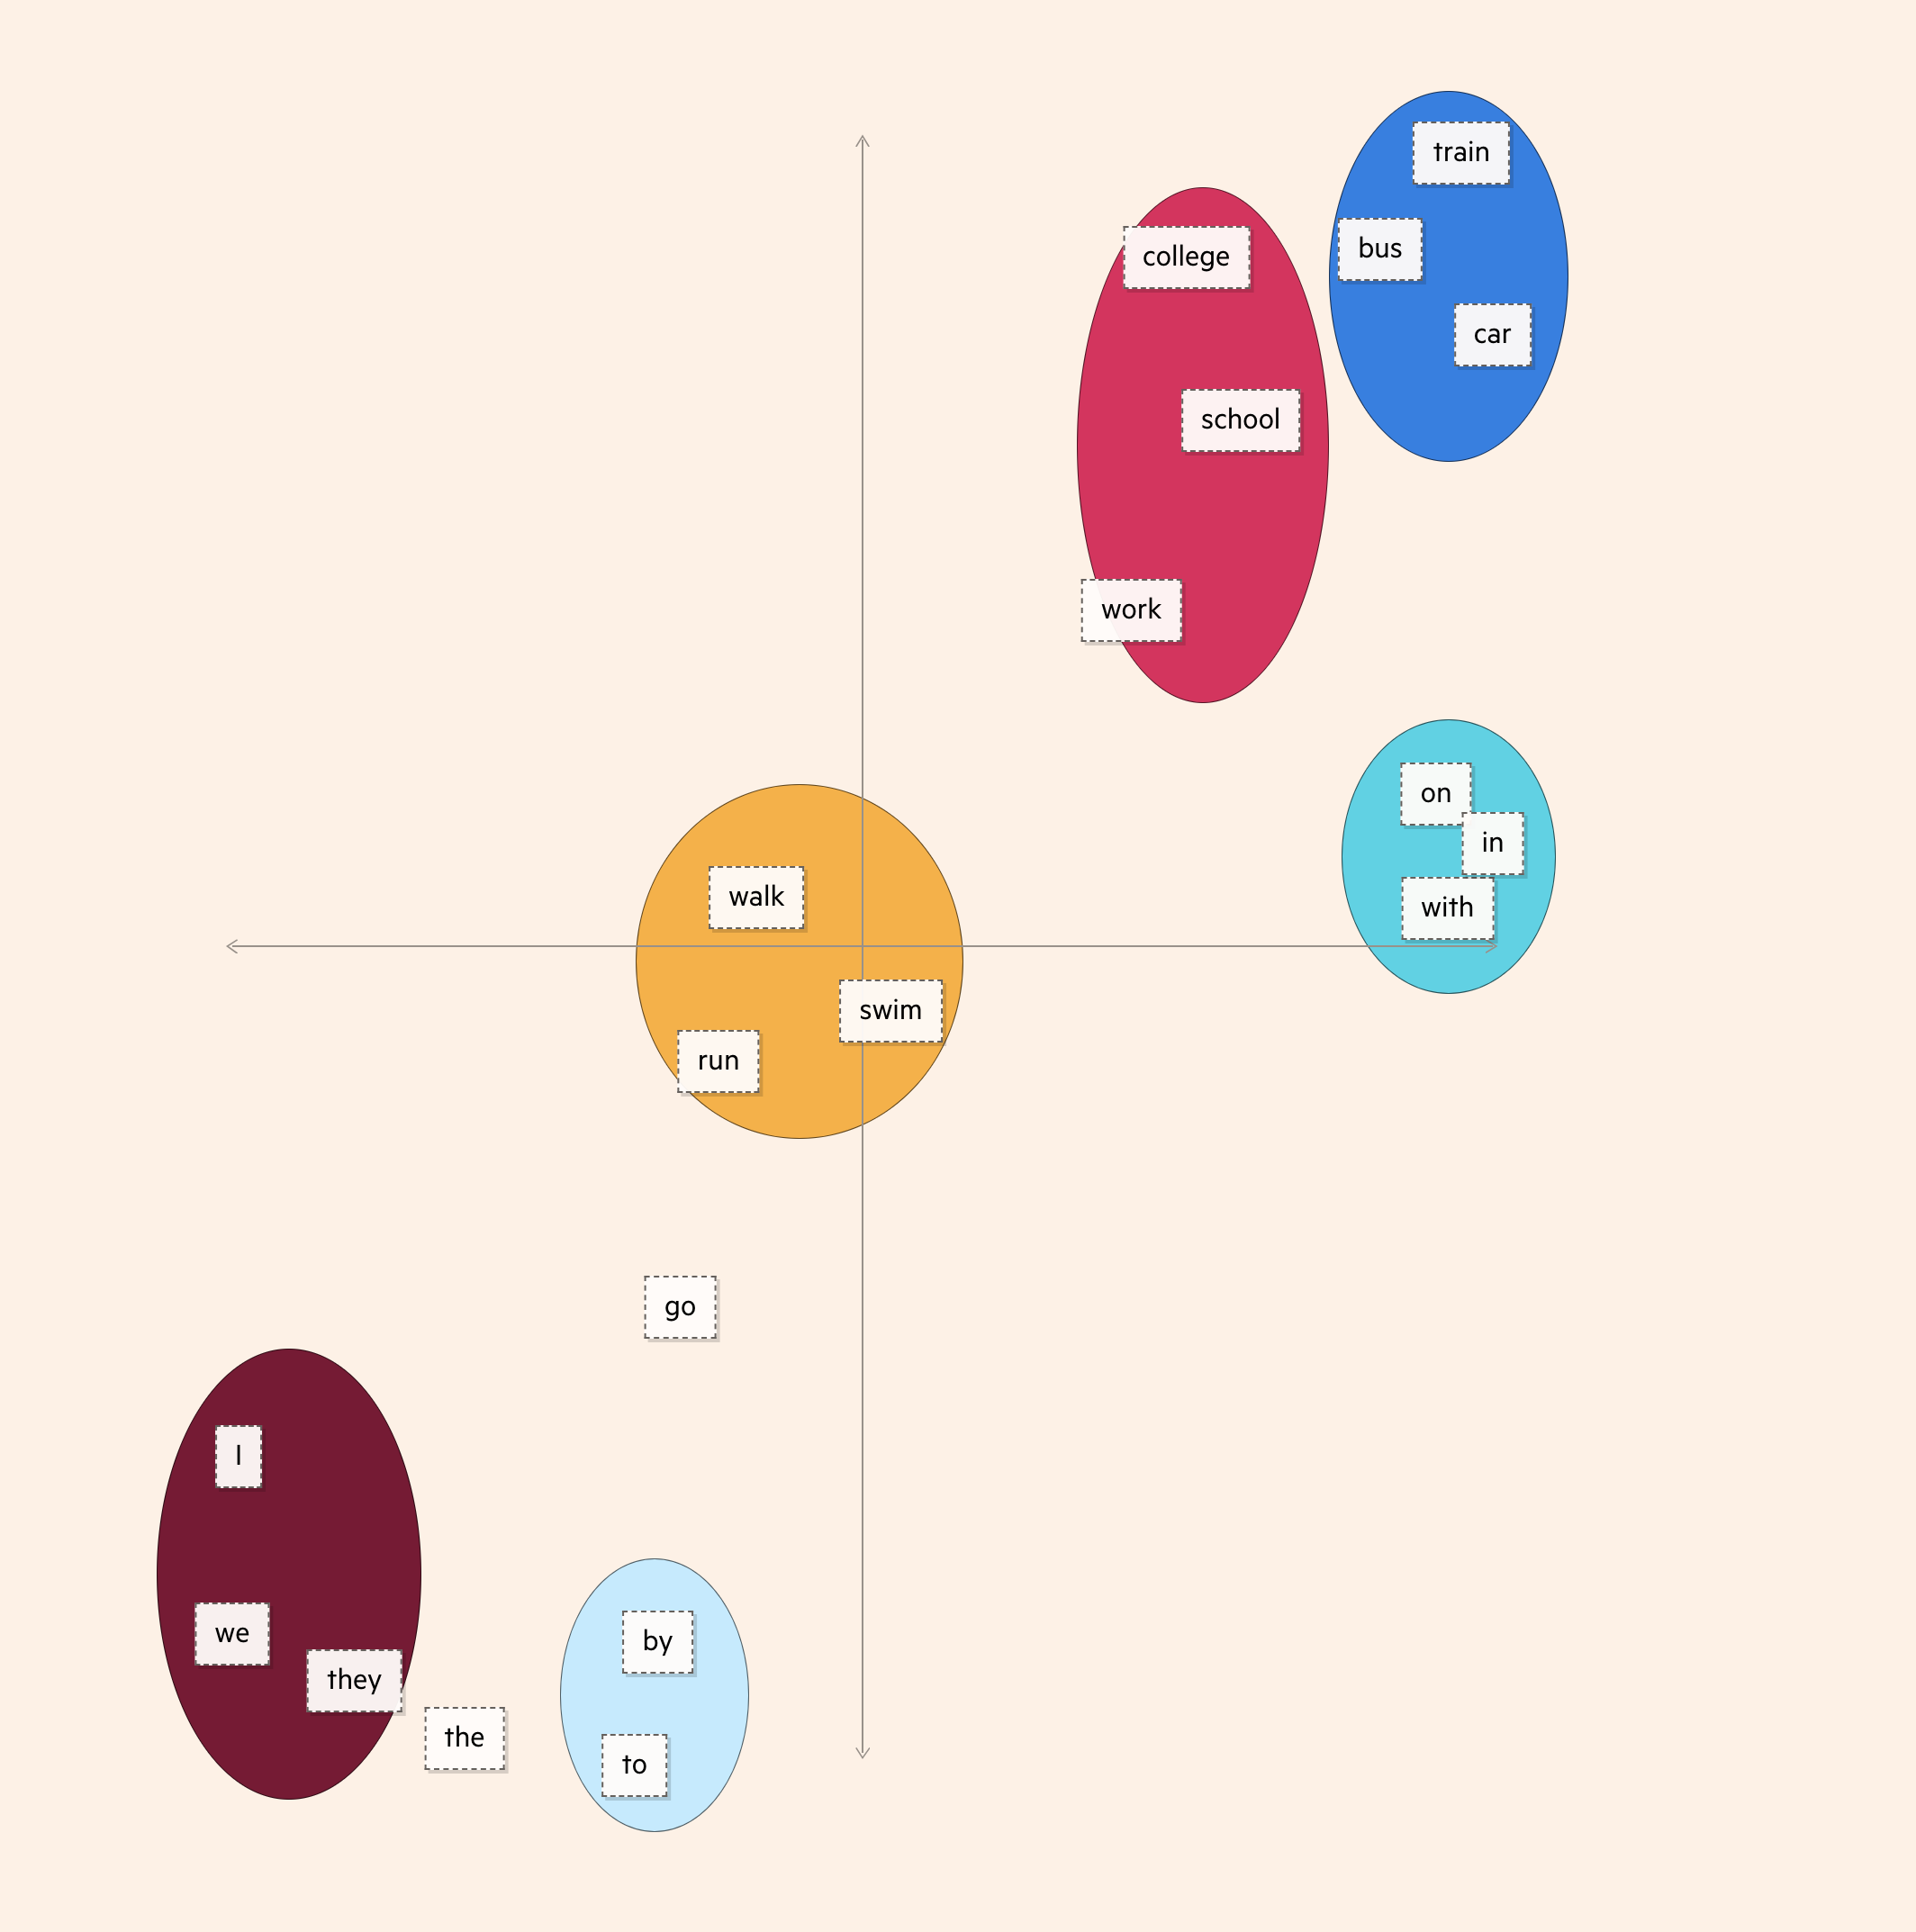
Step 1 - Words are turned into mathematical embeddings
Massive training sets of text from the internet converts words into mathematical representations
The representations of words that are related to each other are ‘closer together’ in space
Source: Financial Times: Generative AI exists because of the transformer

Slide 7
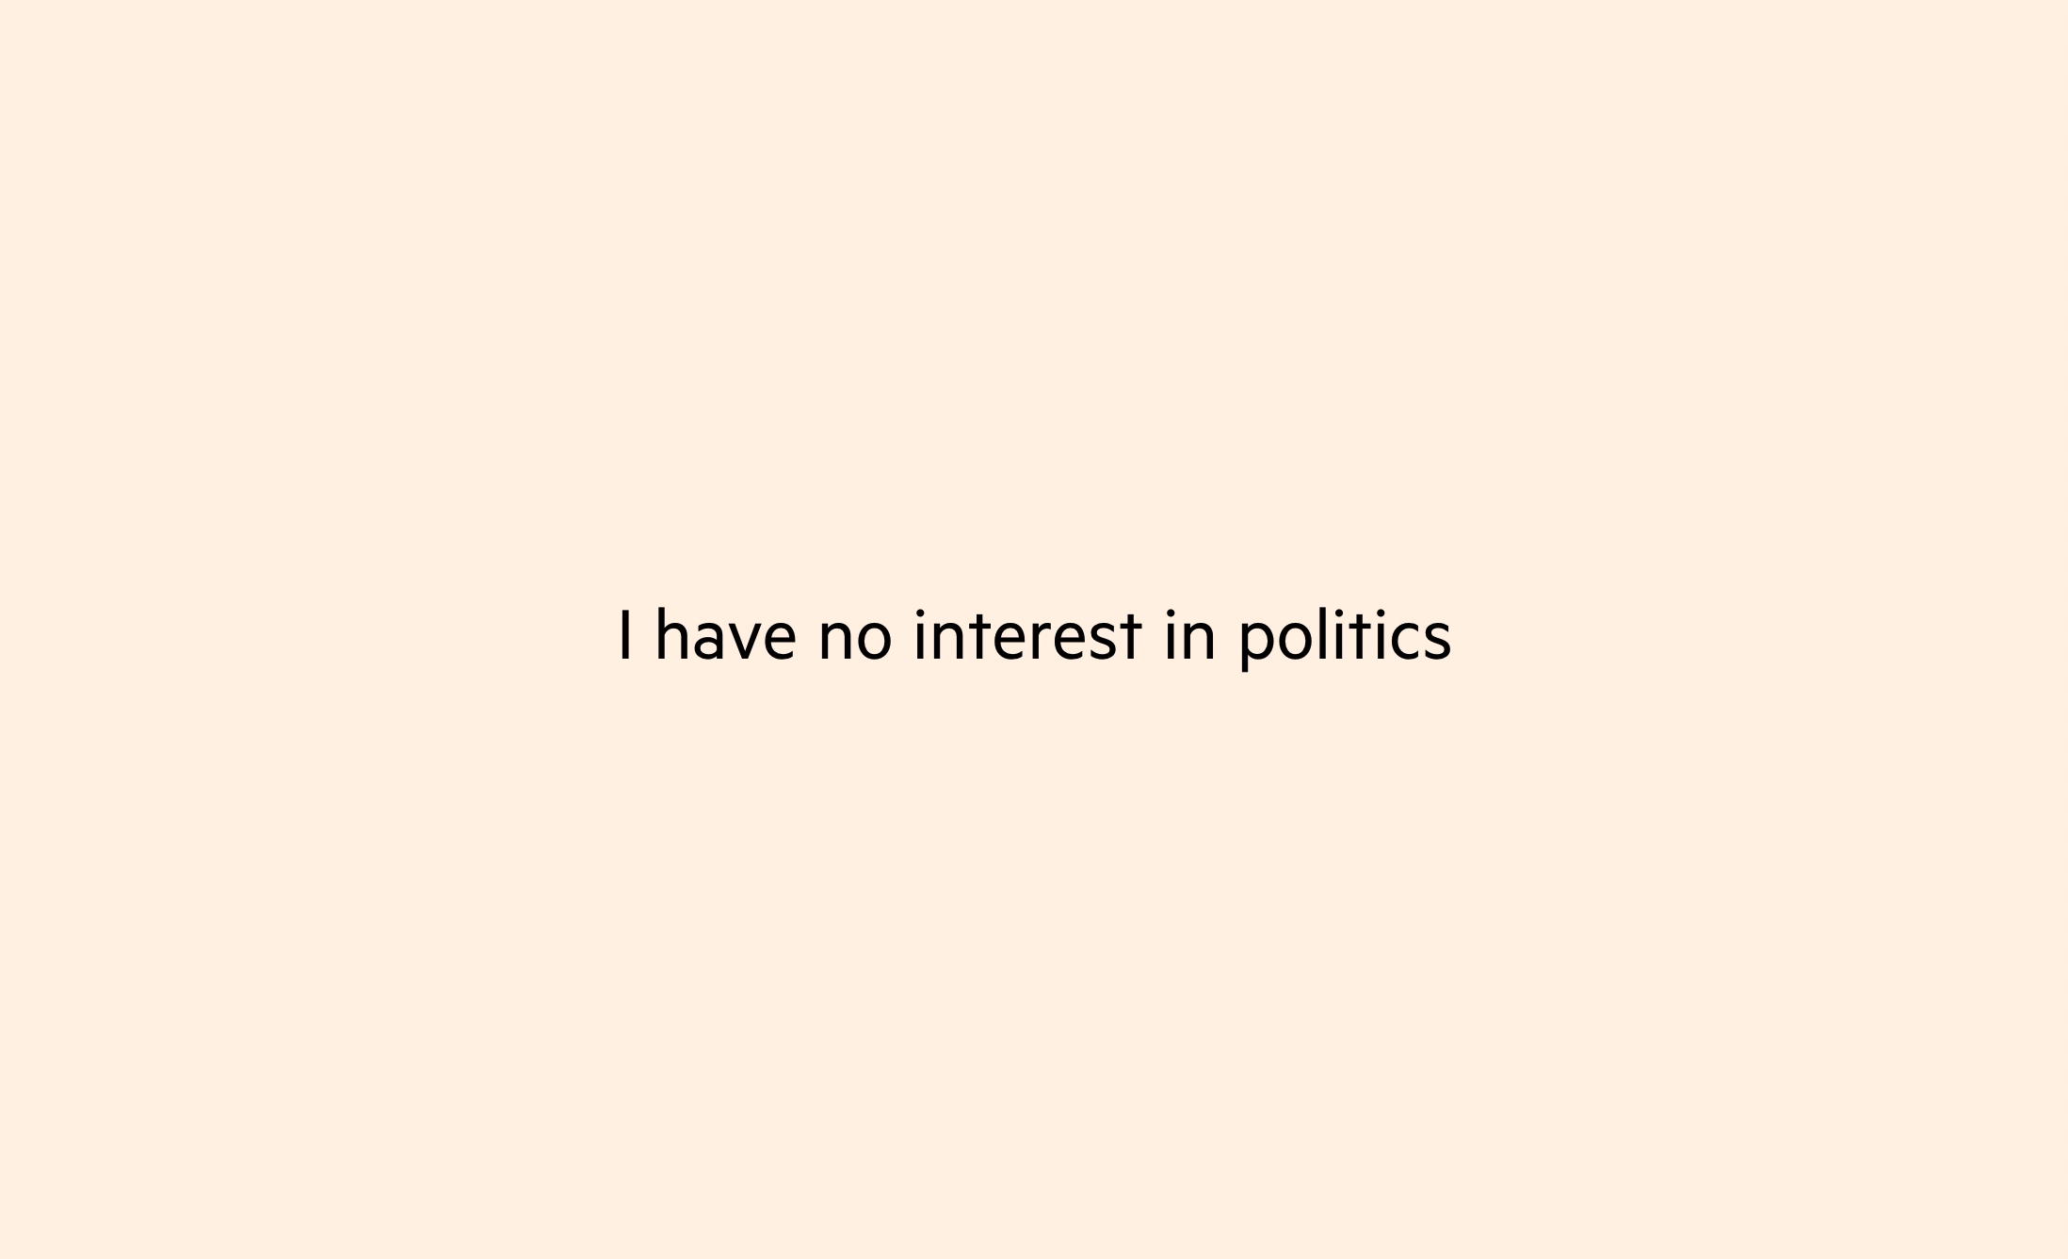
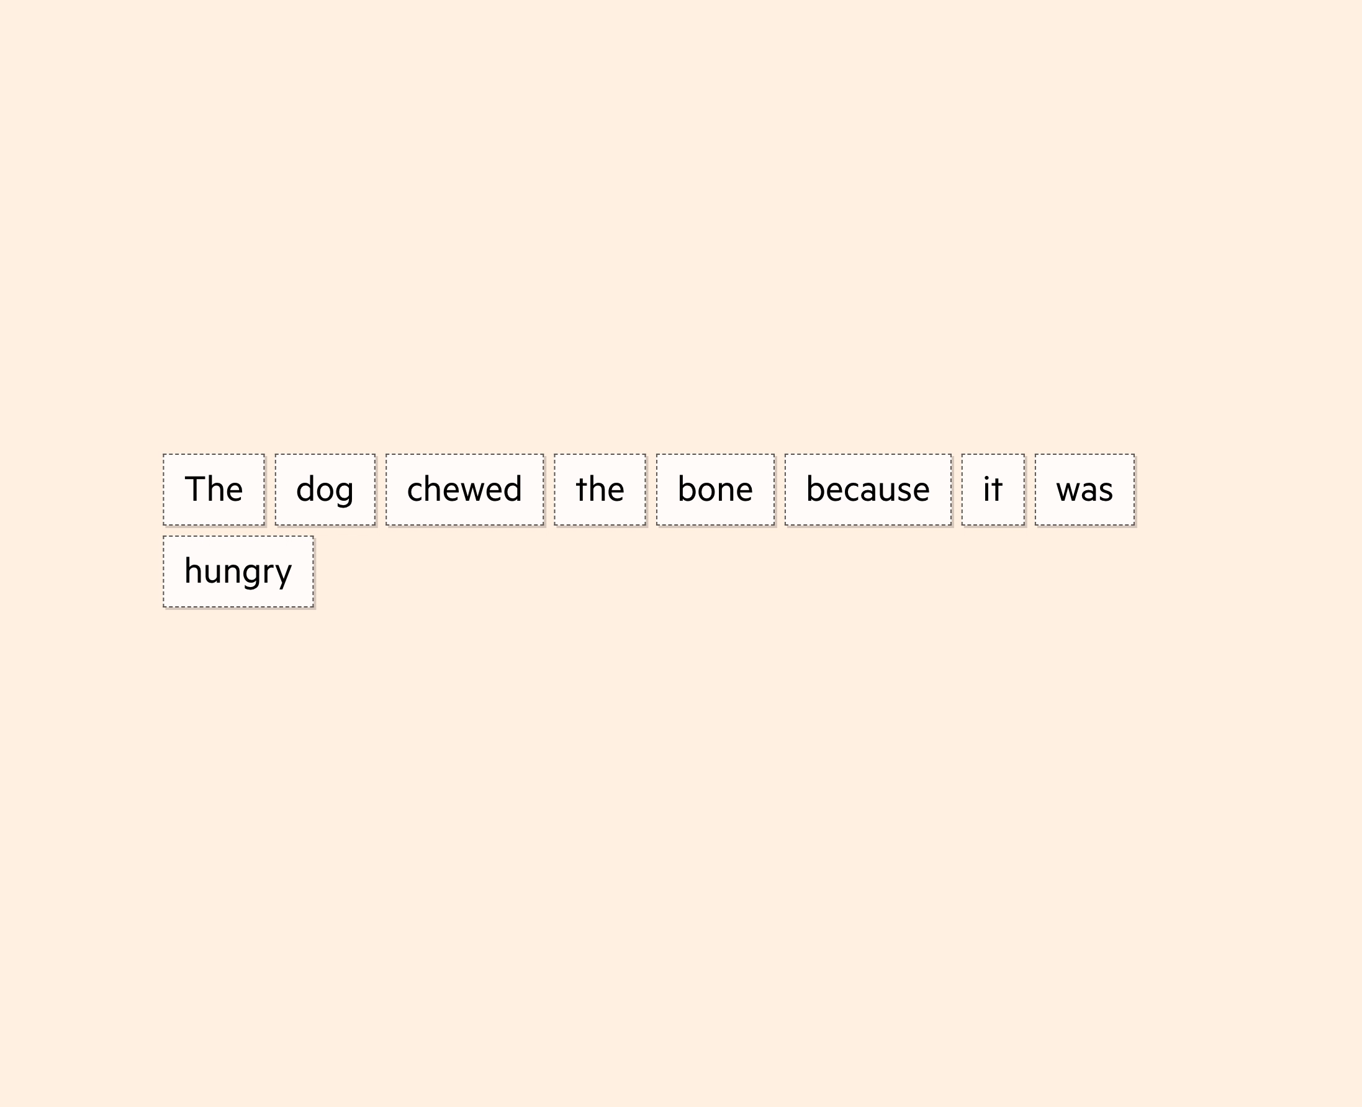
Step 2 – Transformers understand words in their sentence context
Importance and interpretation of words inside a sentence are understood using an algorithmic process called self-attention
This allows the transformer to understand where a word might be replaced with a similar word, or where other phrases in the document might be related
Source: Financial Times: Generative AI exists because of the transformer

Slide 8
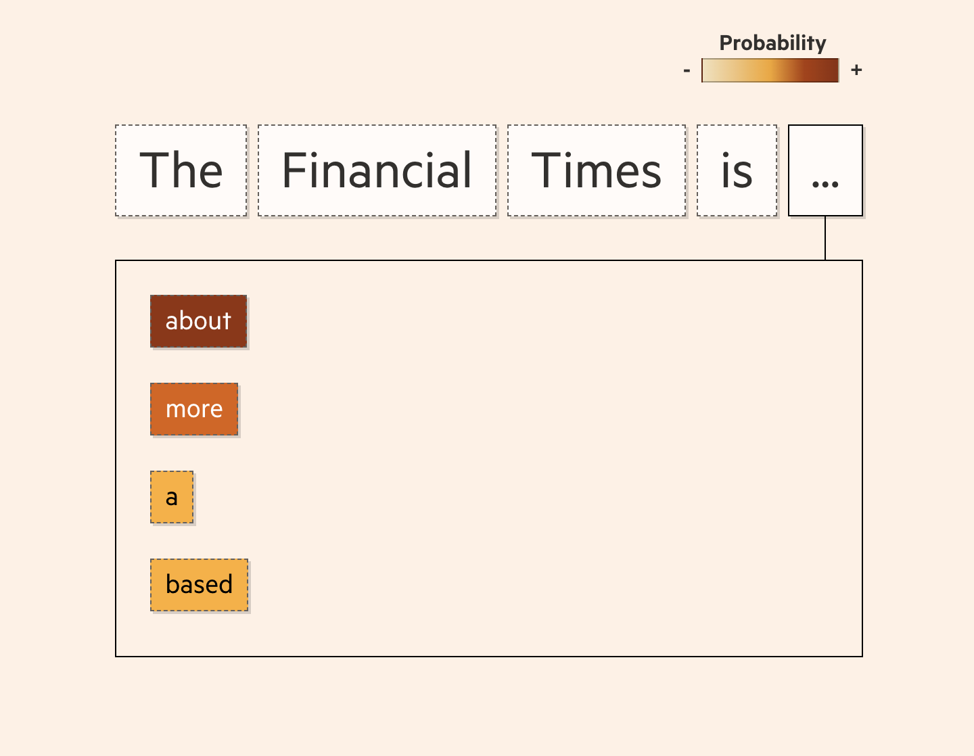
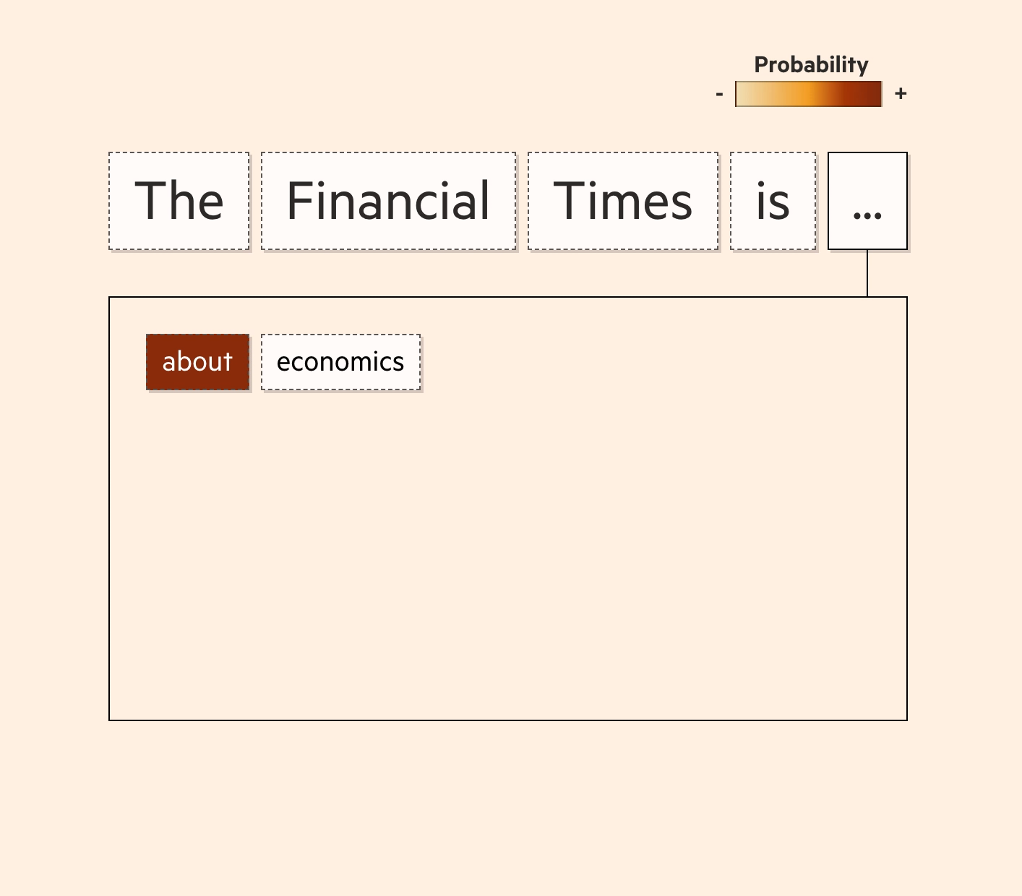
Step 3 – Text is generated based on maximum probability
Many options are generated for the next word in a sentence, each with a probability
The highest probability word is chosen, then repeatedly revisited until the sentence is optimized
Source: Financial Times: Generative AI exists because of the transformer

Slide 9
Agenda
What is GenAI and how does it work?
What are the opportunities and challenges of GenAI?
The Three C’s of Successful GenAI applications
Hands on: Building a GenAI enabled application

Slide 10
Disruption appears to be accelerating
Global automation of time spent on current work activities,¹ %
100
Updated early scenario including generative AI²
80
Updated late scenario including generative AI³
2017 late scenario²
60
Midpoint 2017
2017 early scenario³
50%
40
Midpoint updated
20
0
2020
30
40
50
60
70
80
2090
Includes data from 47 countries, representing about 80% of employment across the world. 2017 estimates are based on the activity and occupation mix from 2016. Scenarios including generative AI are based on the 2021 activity and occupation mix
Early scenario: aggressive scenario for all key model parameters (technical automation potential, integration timelines, economic feasibility, and technology diffusion rates)
Late scenario: Parameters are set for later adaption potential
Source: McKinsey global institute analysis
Notes:
All indicators suggest that this disruption is nowhere near its end. In 2017, a McKinsey report estimated that we will reach a point where 50% of all work activities will be automatable somewhere between 2035 and 2070.
A more recent report has included the impact of more rapid than expected development of large language models and Generative AI, and estimates an acceleration of 10 years on average from previous estimates.
You can access the report on McKinsey’s website or by using the QR code on this slide.

Slide 11





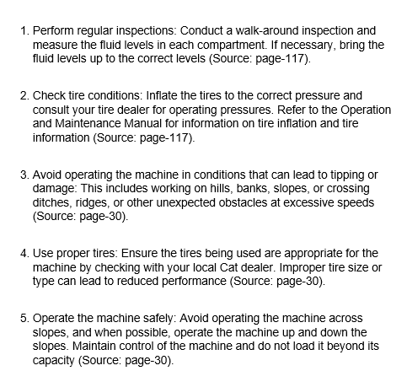

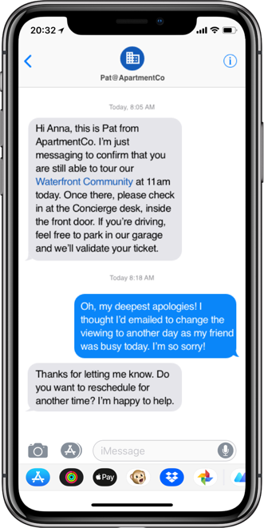
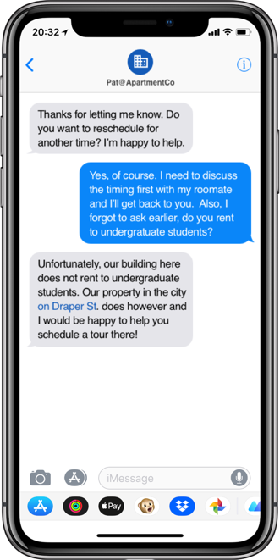

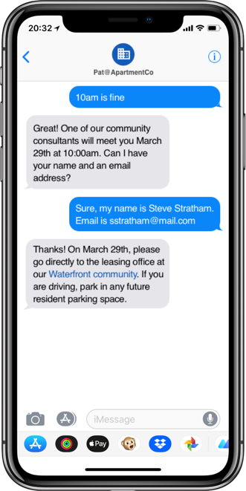
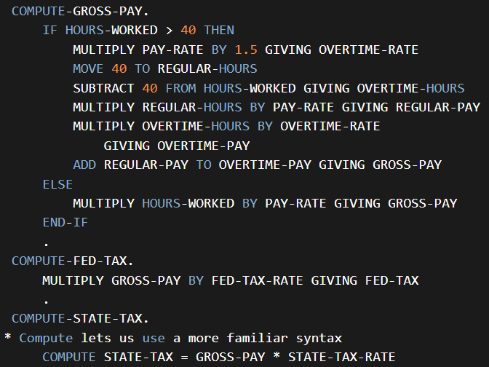
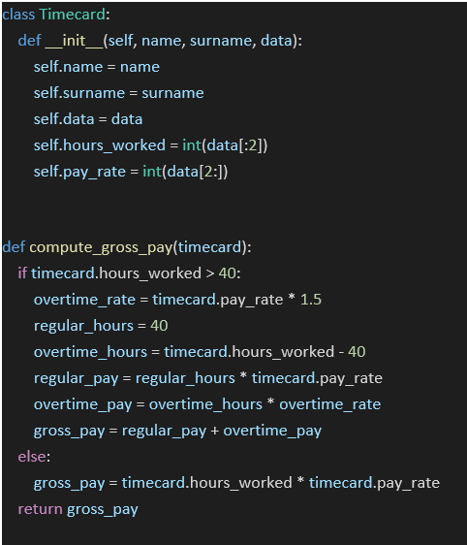

Four leading uses of Generative AI
Content Search & Synthesis
Coding & Software
Content generation
Customer Engagement
Archetype
Description
Summarise insights from large troves of existing documents/resources
Interpret and generate code and documentation
Generate communications, marketing or ideation around a specific initiative
Streamline interactions by ‘triaging’ customer/employee queries using automated chat response
Selected use cases
Give a summary of knowledge on a topic from a large codified knowledge repository
Augment capabilities of operations staff (e.g., chat interface to automatically find the most relevant answers before human assistance)
Generate code and assist developers
Refactor or translate code to accelerate mainframe migration
Automate personalized communications
Generate technical summary documents
Generate specialized content such as interview guides or selection/assessment/evauation rubric
Streamline customer/employee communications, e.g., issue resolution (driving action to resolve) and Q&A
Ensure only more complex queries are handled by humans
Examples
Support desk triage/automation
Code optimization
Automated personalized email campaigns
Always on chat bot

Slide 12
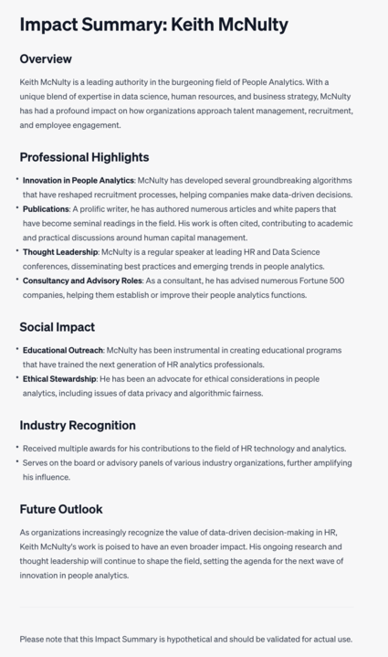
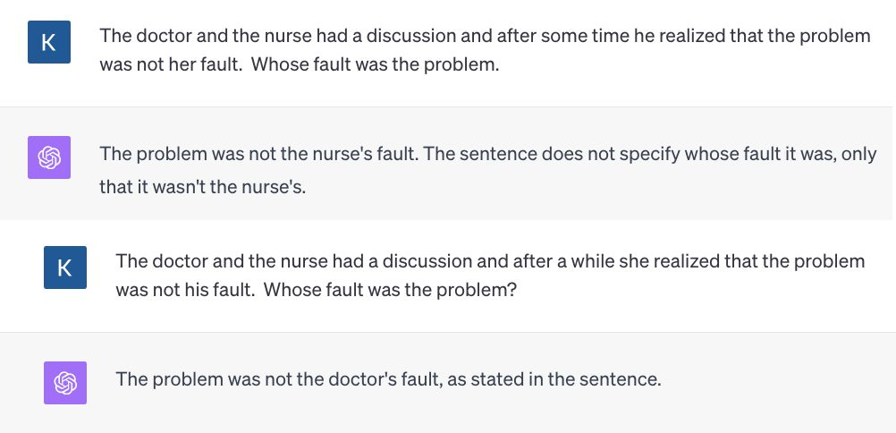
Examples of model hallucination and bias
Notes:
All indicators suggest that this disruption is nowhere near its end. In 2017, a McKinsey report estimated that we will reach a point where 50% of all work activities will be automatable somewhere between 2035 and 2070.
A more recent report has included the impact of more rapid than expected development of large language models and Generative AI, and estimates an acceleration of 10 years on average from previous estimates.
You can access the report on McKinsey’s website or by using the QR code on this slide.

Slide 13
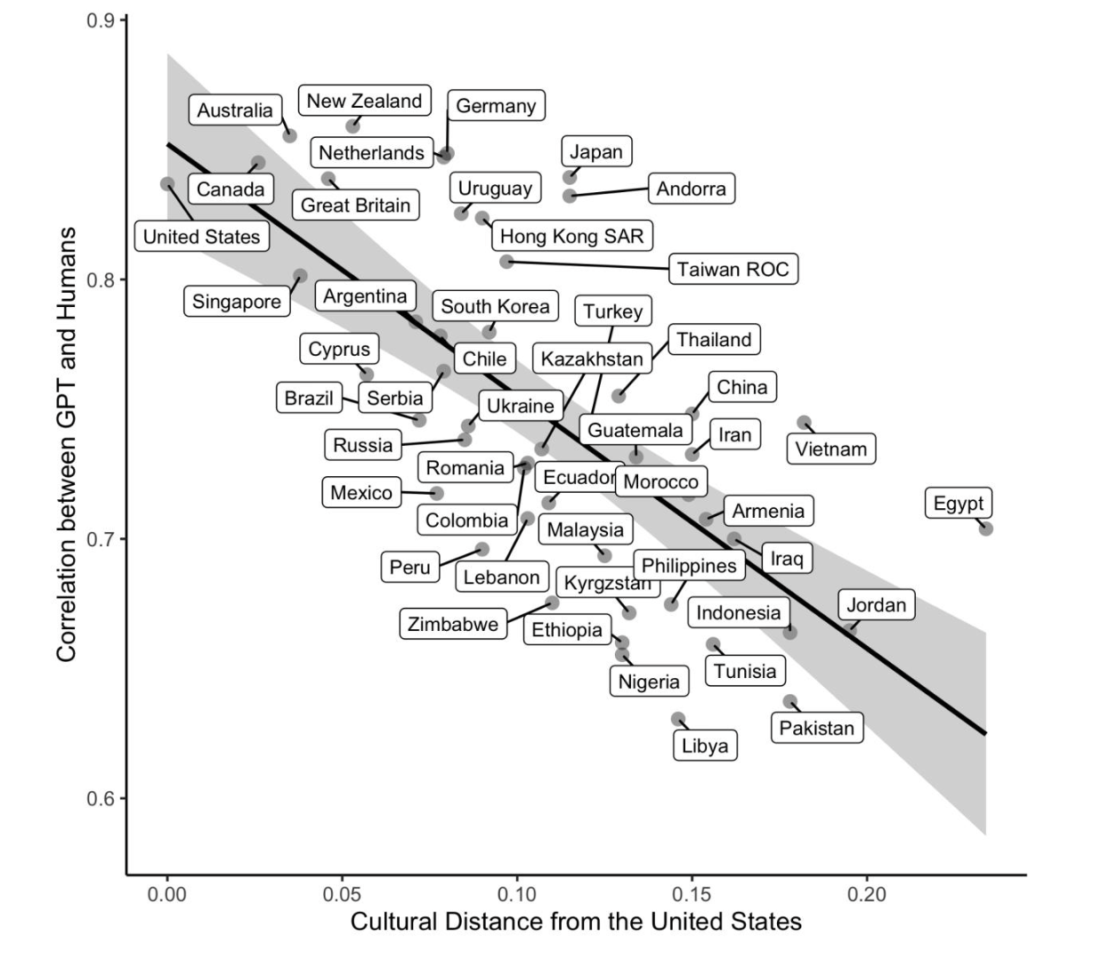
The WEIRD bias
Source: Harvard Department of Human Evolutionary Biology: Which Humans? (Pre-print May 2024)
Notes:
All indicators suggest that this disruption is nowhere near its end. In 2017, a McKinsey report estimated that we will reach a point where 50% of all work activities will be automatable somewhere between 2035 and 2070.
A more recent report has included the impact of more rapid than expected development of large language models and Generative AI, and estimates an acceleration of 10 years on average from previous estimates.
You can access the report on McKinsey’s website or by using the QR code on this slide.

Slide 14

‘Slop’ is the new Spam
Slop is a new term that is growing to describe an emerging negative impact of Generative AI, similar to spam in email.
It describes situations where it can be financially profitable to artificially generate content and use it with no human quality control
For example, money can be made from generating a page of web content through including ads. Even if the content is really poor, if many pages of content can be generated automatically at scale and they are credible enough for people to click on them, they can make revenue.
This could result in the ‘zombie internet’ – littered with so much unreliable information that it becomes harder to discern what is reliable.
Like how spam has been handled, this will likely require significant collaboration among tech firms to deal with
Notes:
All indicators suggest that this disruption is nowhere near its end. In 2017, a McKinsey report estimated that we will reach a point where 50% of all work activities will be automatable somewhere between 2035 and 2070.
A more recent report has included the impact of more rapid than expected development of large language models and Generative AI, and estimates an acceleration of 10 years on average from previous estimates.
You can access the report on McKinsey’s website or by using the QR code on this slide.

Slide 15
Agenda
What is GenAI and how does it work?
What are the opportunities and challenges of GenAI?
The Three C’s of Successful GenAI applications
Hands on: Building a GenAI enabled application

Slide 16

The Three C’s: Context, Control and Cost
Context
Models need to provide relevant information to be useful and add value
Most models will not have relevant information in proprietary enterprise/organizational settings
Retrieval Augmented Generation (RAG) is an inexpensive way to provide context to models, but has limitations
Control
Models can produce inaccurate information which can be dangerous if used without controls
Controlling generative models is hard. Context setting and prompt engineering are key methods, but are not fool-proof
High stakes model settings are particularly vulnerable to control risks
Costs
Uncontrolled use of proprietary models can be costly
Sometimes SLMs can work as well as LLMs for basic summarization
When does hosting your own model become more cost effective that using vendor models?
Notes:
All indicators suggest that this disruption is nowhere near its end. In 2017, a McKinsey report estimated that we will reach a point where 50% of all work activities will be automatable somewhere between 2035 and 2070.
A more recent report has included the impact of more rapid than expected development of large language models and Generative AI, and estimates an acceleration of 10 years on average from previous estimates.
You can access the report on McKinsey’s website or by using the QR code on this slide.

Slide 17
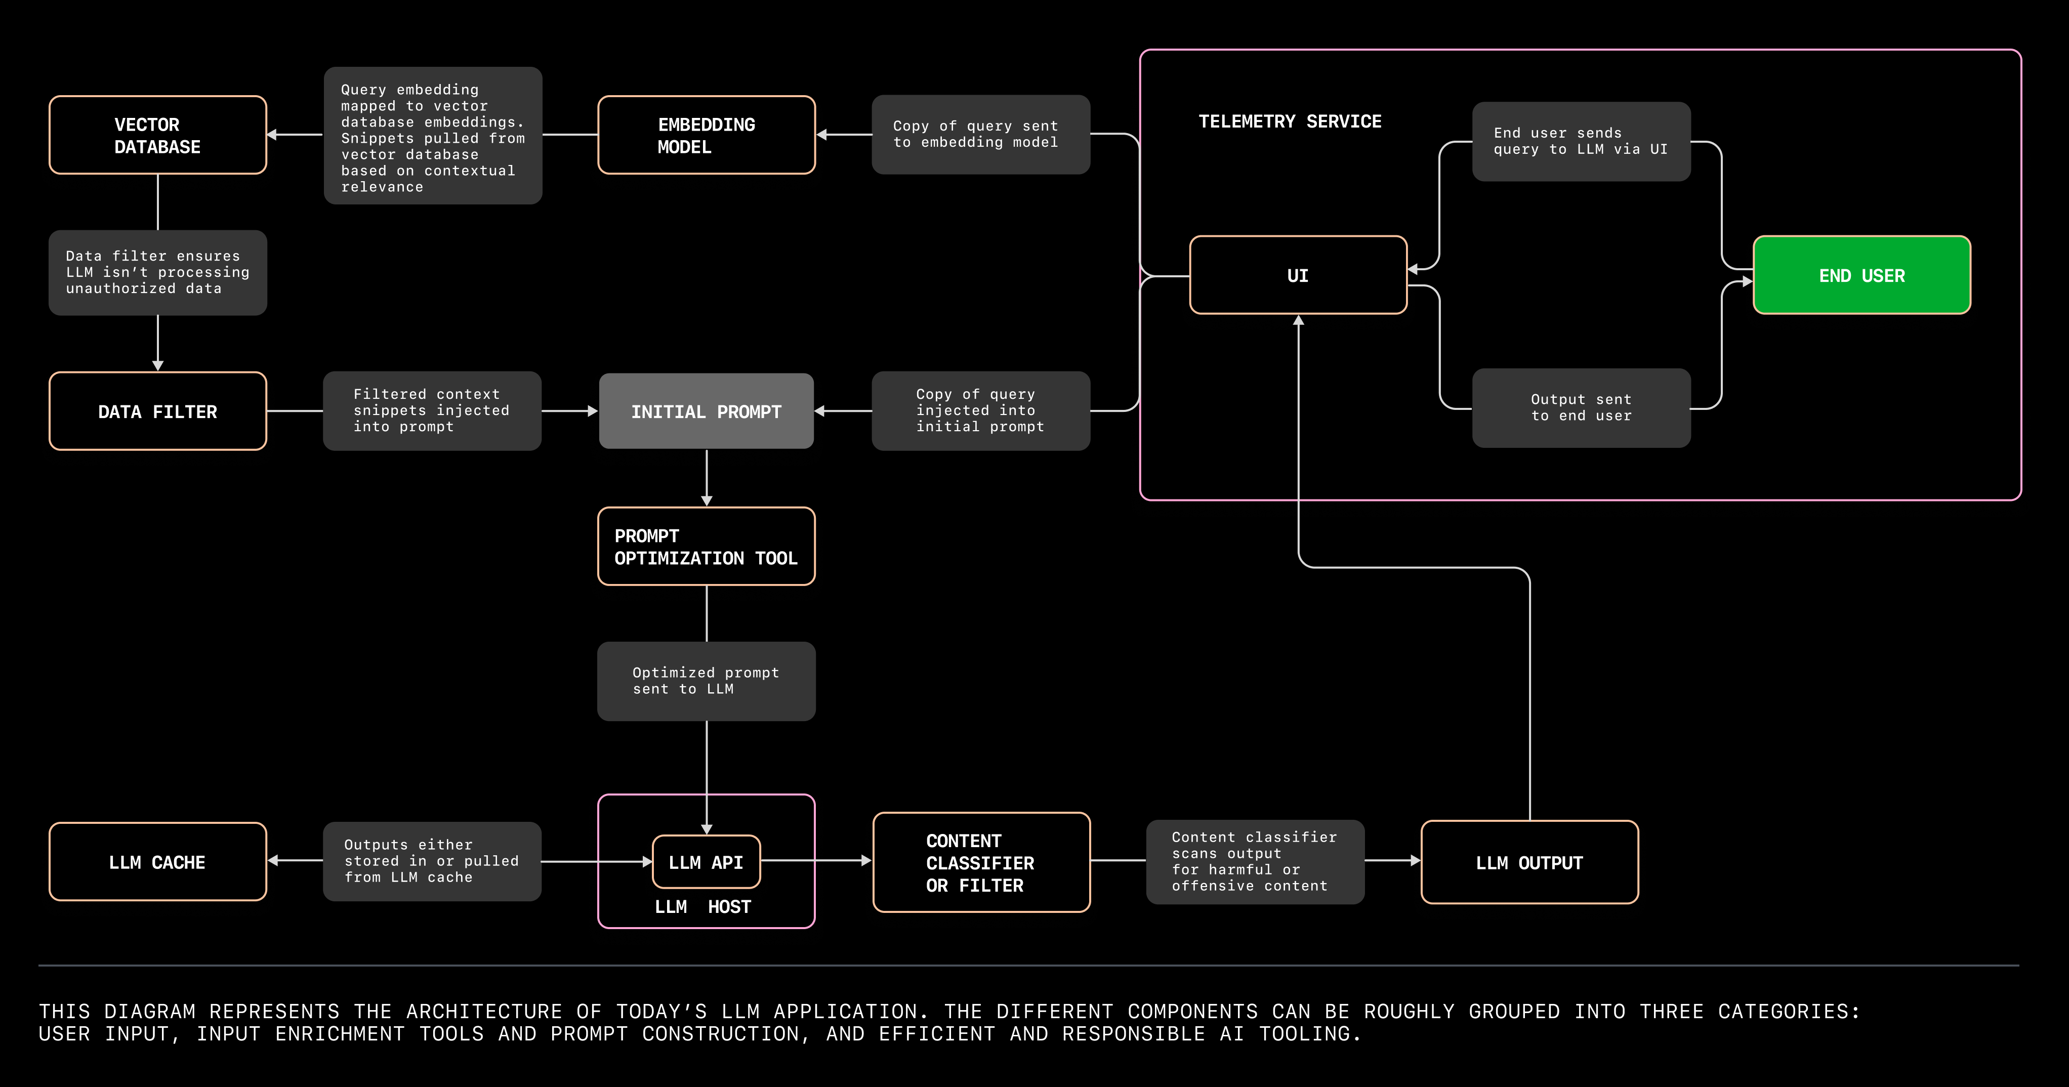
Emerging application architecture
Notes:
All indicators suggest that this disruption is nowhere near its end. In 2017, a McKinsey report estimated that we will reach a point where 50% of all work activities will be automatable somewhere between 2035 and 2070.
A more recent report has included the impact of more rapid than expected development of large language models and Generative AI, and estimates an acceleration of 10 years on average from previous estimates.
You can access the report on McKinsey’s website or by using the QR code on this slide.

Slide 18
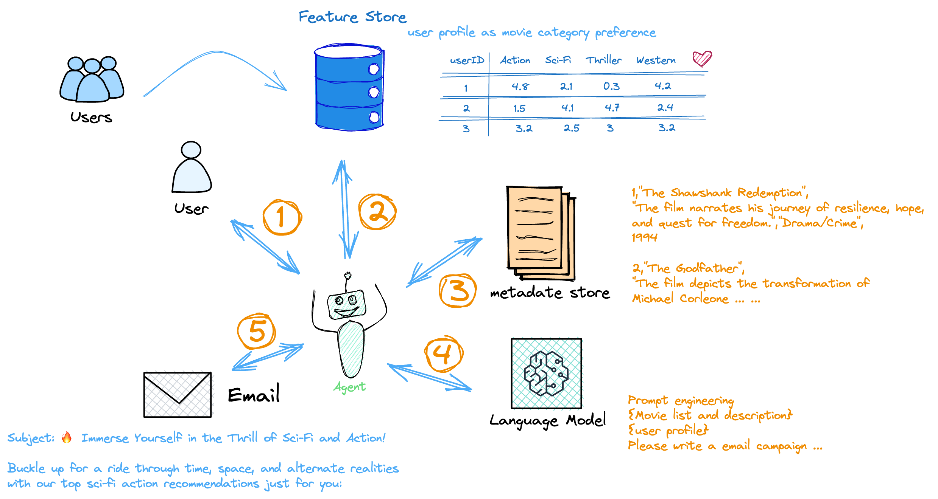
The AI Agent concept
Notes:
All indicators suggest that this disruption is nowhere near its end. In 2017, a McKinsey report estimated that we will reach a point where 50% of all work activities will be automatable somewhere between 2035 and 2070.
A more recent report has included the impact of more rapid than expected development of large language models and Generative AI, and estimates an acceleration of 10 years on average from previous estimates.
You can access the report on McKinsey’s website or by using the QR code on this slide.

Slide 19
Agenda
What is GenAI and how does it work?
What are the opportunities and challenges of GenAI?
The Three C’s of Successful GenAI applications
Hands on: Building a GenAI enabled application

